Slide 1
Railway guide application
Your names…

Slide 2
Problem statement
The main aim of the project was to develop a application which would facilitate to access information about train, station layout, nearest tourist places etc through an effective and yet simple GUI for a normal passenger intending to travel in railways.

Slide 3
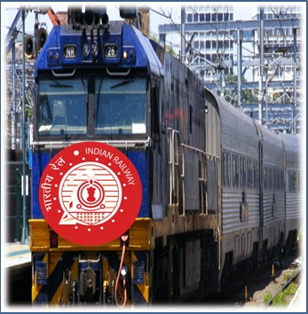
Motivation
So many people travel daily in train and came across so many railway station and platforms.
There is always problem to locate a book stall, canteen, bathroom, waiting room etc. on unknown station/platform.
So we wanted to build an android app which will inform you which will be the next coming station and what is the layout of stations, like how many platforms, where is police station on map.

Slide 4
Related Work Done
Indian Rail Guide App
Indian Rail Guide is a complete travel companion app for the frequent travellers of Indian Railways. With Indian Railway Guide, you can access train ticket status, train timetable, train live running information, train seat availability, train fare, train arrivals/departures at a station and much more from your mobile.
Limitations: Only static information is provided

Slide 5
IndRail Indian Railway App
Using IndRail you can get information about Indian Railway(s) such as current PNR Status, Seat Availability, Fare Enquiry, Train Routes, and information of any train.
Limitations: Only static information is provided
Indian Rail Train, IRCTC Info
Indian Rail Train, IRCTC Info App is developed to easily access information regarding indian rail way reservation.
Limitations: Very Less features.

Slide 6
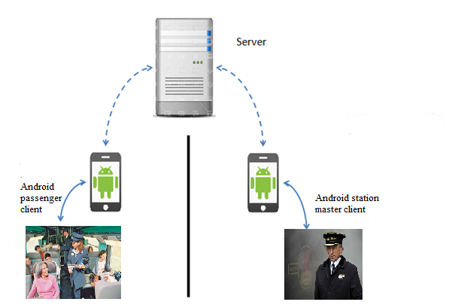
Block diagram

Slide 7
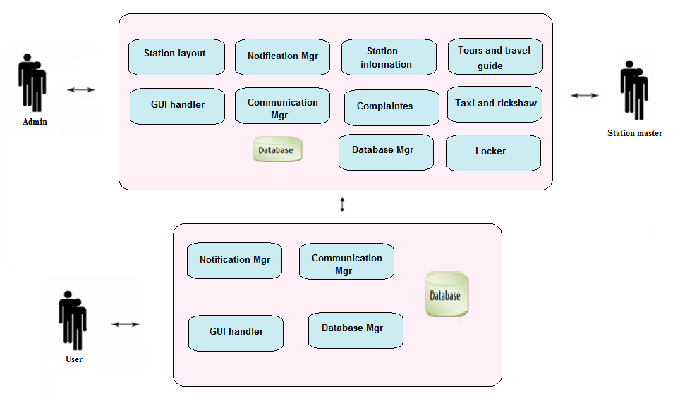
Architecture diagram

Slide 8
Description
Passenger Module
The passenger can register to use the app creating id, password.
The passenger can login to the system with its own id and password created at the time of registration.
The passenger will be receiving the notification of arrival of the next station.
The passenger can view the whole platform wise layout of a particular station

Slide 9
The passenger can set a reminder of the particular station, which when arrives, the application will send an alert sound or vibrate.
The passenger will be able to view the amount of time the train is going to wait at the particular station.
The passenger’s location is sent to the people he/she is going to visit.

Slide 10
Station Master
The station master can login to his account of his station.
The station master can send important notification to the passenger on the station.
If baggage is reported lost the immediately notify the station staff and the other station masters, where ever the train is going to stop.

Slide 11
Station layout module
End user can search for next coming station and can see the layout of next station.
It check all shops, tea stall, hotel on the coming station, number of platform, on which platform train will arrive etc. Station master add the station layout, information of station.

Slide 12
Station information:
Displays the time table of the trains i.e arrival and departure time of the train.
Cost of tickets according date , the train and the source and destination.
Whenever the train has been delayed the passengers will be notified of this delay and the new arrival time.

Slide 13
Notification
The passenger can set a reminder of the particular station, which when arrives, the application will send an alert sound or vibrate.
Before 30 sec user get notification that train is living in 30 sec from platform.
The passenger will be able to view the amount of time the train is going to wait at the particular station.
All information of arriving time of train, departure time of train, route add by station master.

Slide 14
Complaints:
Passenger can post complaints about the services in the train.
The passenger can receive alerts and alarms for protection against thefts to take precaution.
If baggage is reported lost then station master immediately notify the station staff and the other station masters, where ever the train is going to stop.

Slide 15
Tours and travel guide:
The passenger can access information about various tourist places at the particular station.
Passenger can access all the information of nearest tourist places like how far from station, rickshaw, taxi available or not etc.

Slide 16
Taxi and rickshaw:
The passenger can book a prepaid taxi or rickshaw from mobile at any station.
Locker
Number of locker, available locker, booked locker all information is add station master. Our user can access all this information and passenger can book a locker.

Slide 17
Technology used
Android
Android is a recently developed operating system designed for mobile devices. It was developed by Google and uses a Linux based kernel, Java compatible libraries along with the just-in-time compiler for development in the Java programming language.
It supports many hardware components. Common hardware consists of cameras, a WiFi communications chip, cellular commutations chip, Bluetooth sender and receiver.
We will develop station master and passenger app in android

Slide 18
Testing

Slide 19
Mathematical model
Set Theory
Let ‘S’ be the ‘Railway Guide Application’.
S= {…………….}
Set S is divided into 6 modules
S= {S1, S2, S3, S4, S5, S6}
S1= GUI Handler (GH)
S2= Location Manager (LM)
S3= Station Layout Logic (SLL)
S4= Locker Module (LM)
S5= Communication Manager (CM)
S6= Travel Guide (TG)

Slide 20
Identify the inputs.
Inputs = {X1, X2, X3, ……..Xn}
X1= Location Information
X2= Locker Information
Identify the output as O.
Outputs = {Y1, Y2, Y3, ……..Yn}
Y1= Station Layout
Y2= Locker Room
Y3= Travel Info

Slide 21
Future scope

Slide 22
Limitation
1.Network dependant
This application requires continuous internet, if network gone our application is not working
2.Location dependency
Requires GPS in our mobile, If there is problem in GPS then we get error in finding latitude and longitude

Slide 23
Deployment

Slide 24
Case study

Slide 25
References
www.indianrailapp.com
indian-rail-indianrail-railway.android.informer.com
www.9apps.com/android-apps/Indian-Railway-Guide
indian-rail-info-app.android.informer.com
Railway Audit Report, Chapter 1Computerized Passenger Reservation System of the Indian Railways, Report No 11 of 2007.
http://borjournals.com/Research_papers/Jun_2013/1356IT.pdf

Slide 26
Conclusion
In this project railway passenger can get all information of platform, trains, station layout, information about nearest places, locker etc
This is very user friendly application made in android and java technology.

Slide 27
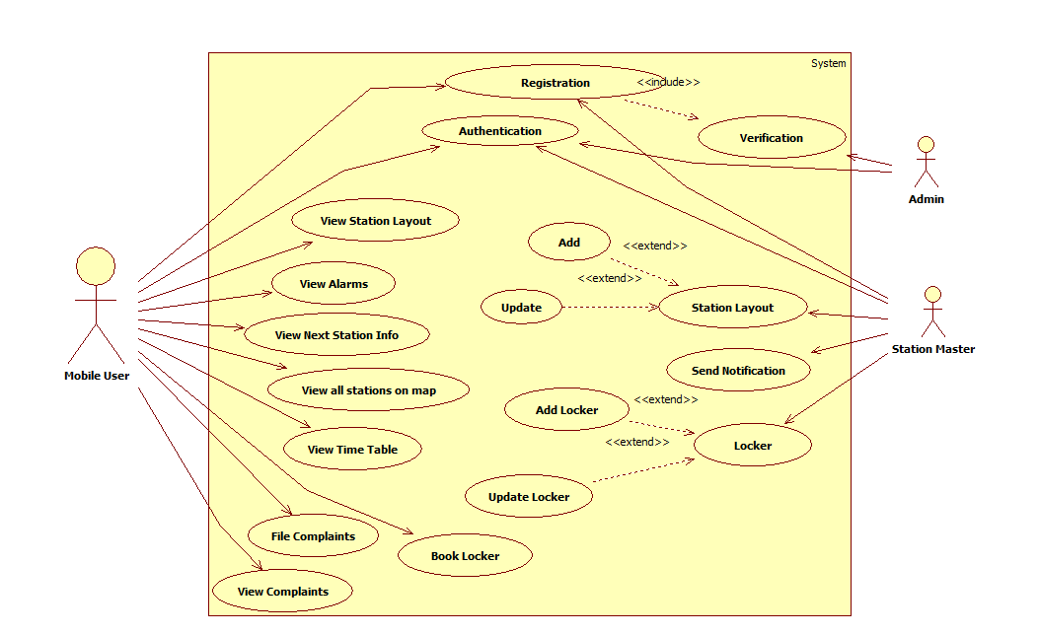
UML diagrams

Slide 28
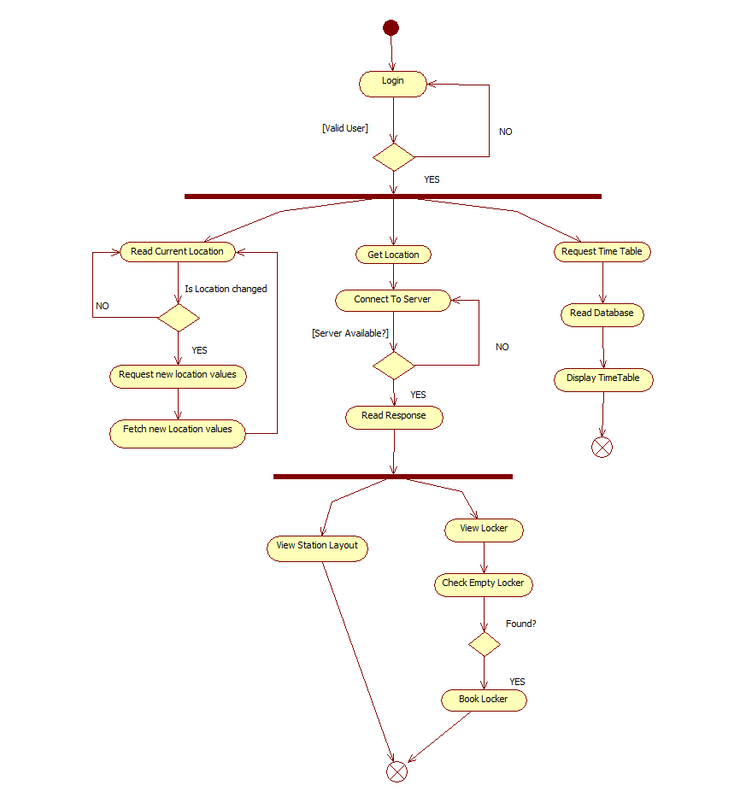
Activity diagram

Slide 29
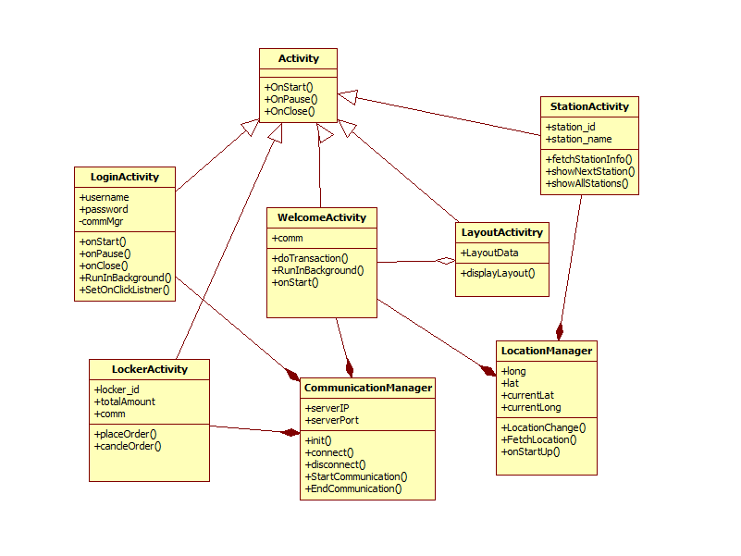
Class diagram

Slide 30
Thanks
Questions..

